Slide 1
L3 BIASING CIRCUITS,LOAD LINE & Q POINT

Slide 2
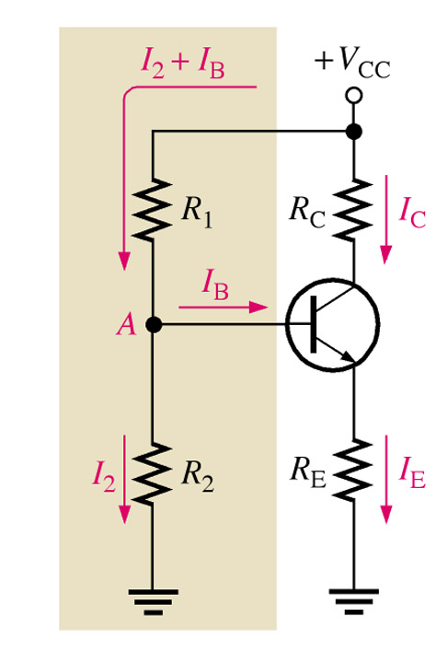
Voltage-Divider Bias
Voltage-divider bias is the most widely used type of bias circuit. Only one power supply is needed and voltage-divider bias is more stable(β independent) than other bias types. For this reason it will be the primary focus for study.
dc bias voltage at base of transistor is developed by a resistive voltage-divider consists of R1 and R2.
Vcc is dc collector supply voltage. Two(2) current path between point A and ground: one through R2 and the other through BE junction and RE.
Notes:
Fig 5-9 Voltage-Div. Bias

Slide 3
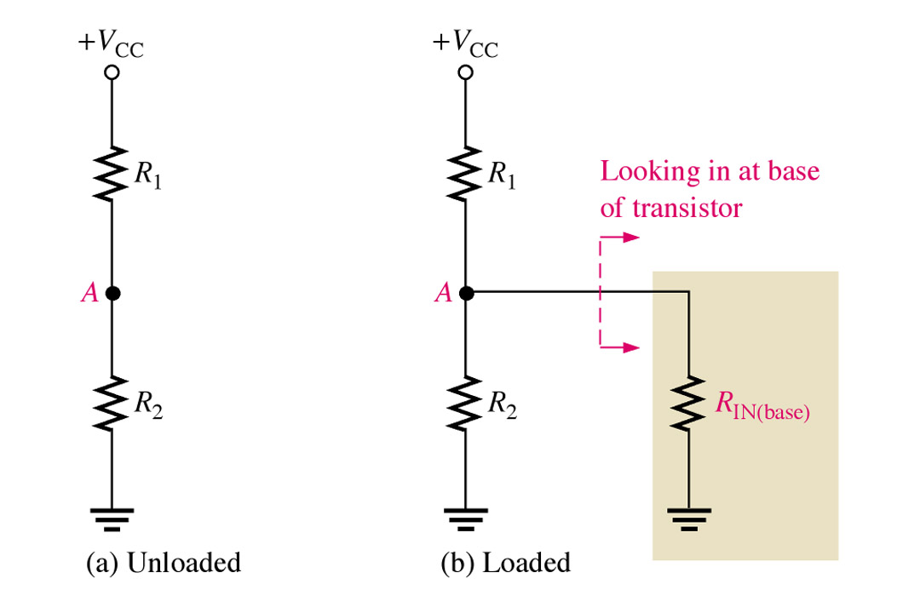
Voltage Divider Bias
If IB is much smaller than I2, bias circuit is viewed as voltage divider of R1 and R2 as shown in Figure a.
If IB is not small enough to be neglected, dc input resistance RIN(base) must be considered. RIN(base) is in parallel with R2 as shown in figure b.

Slide 4
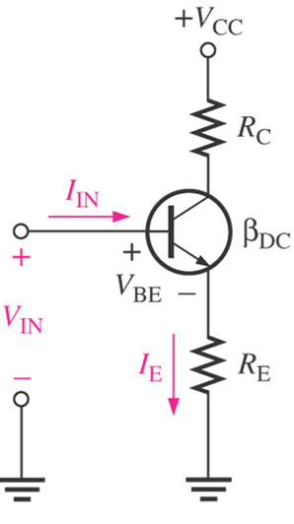
Input Resistance At Transistor Base
V_{IN} is between base and ground and I_{IN} is the current into base.
By Ohm’s Law,
R_{IN(base)} = V_{IN} / I_{IN}
Apply KVL, V_{IN}=V_{BE}+I_{E}R_{E}
Assume V_{BE}<<I_{E}R_{E}, so V_{IN}≈I_{E}R_{E}
Since I_{E}≈I_{C}=β_{DC}I_{B},
V_{IN}≈ β_{DC}I_{B}R_{E}
I_{N}=I_{B}, so
R_{IN(base)}= β_{DC}I_{B}R_{E} / I_{B}
R_{IN(base)} = β_{DC}R_{E}
Notes:
Fig 5-10a & b

Slide 5
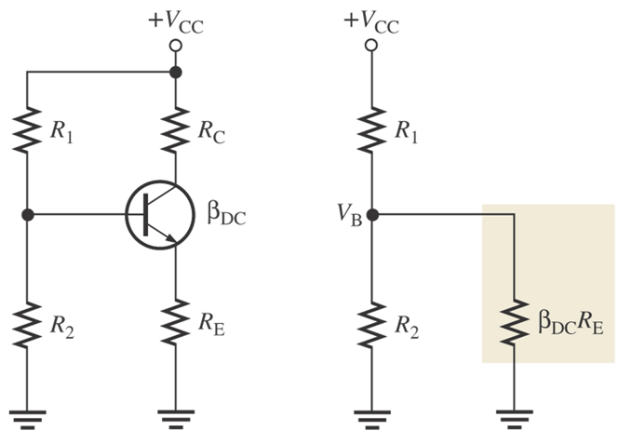
Analysis of Voltage-Divider Bias Circuit
Notes:
Fig 5-9 Voltage-Div. Bias

Slide 6
Analysis of voltage divider bias circuit
Total resistance from base to ground is:
A voltage divider is formed by R1 and resistance from base to ground in parallel with R2.
If β_{DC}R_{E} >>R₂, (at least ten times greater), then the formula simplifies to

Slide 7
Analysis of Voltage-Divider Bias Circuit
Now, determine emitter voltage V_{E}.
V_{E}=V_{B} – V_{BE}
Using Ohm’s Law, find emitter current I_{E}.
I_{E} = V_{E} / R_{E}
All the other circuit values
I_{C} ≈ I_{E}
V_{C} = V_{CC} – I_{C}R_{C}
To find V_{CE}, apply KVL:
V_{CC} – I_{C}R_{C} – I_{E}R_{E} – V_{CE} =0
Since I_{C} ≈ I_{E},
V_{CE} ≈ V_{CC} – I_{C} (R_{C} + R_{E})
Notes:
Fig 5-9 Voltage-Div. Bias

Slide 8
Voltage-divider bias characteristics.
Circuit recognition: The voltage divider in the base circuit.
Advantages: The circuit Q-point values are stable against changes in temperature
Disadvantages: Requires more components than most other biasing circuits.
Applications: Used primarily to bias linear amplifier.
h_{FE}. (which is also referred to as β)

Slide 9
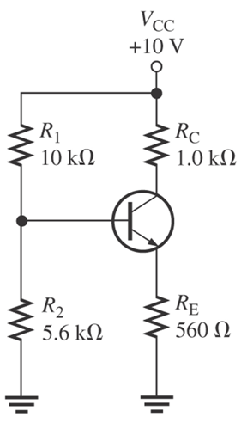
Example
Determine VCE and IC in voltage-divider biased transistor circuit below if βDC=100.

Slide 10
Solution
Determine dc input resistance at base to see if it can be neglected.
R_{IN(base)}=10R2, since β_{DC}R_{E} >>R₂ R_{IN(base)}. Then, find base voltage
So, emitter voltage
And emitter current
Thus,
And V_{CE} is

Slide 11
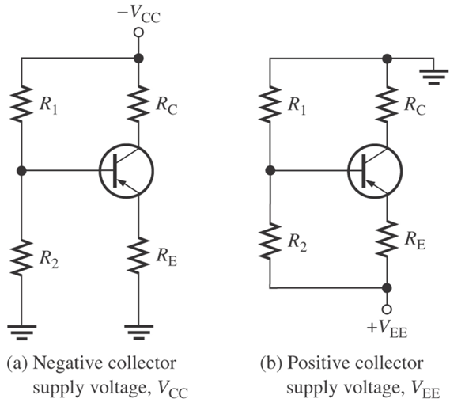
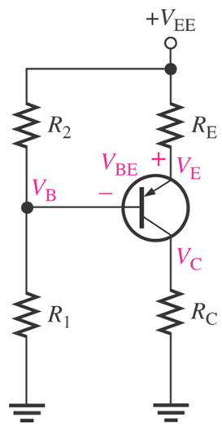
Voltage-Divider Bias for PNP Transistor
Pnp transistor has opposite polarities from npn. To obtain pnp, required negative collector supply voltage or with a positive emitter supply voltage. The analysis of pnp is basically the same as npn.
Notes:
Fig 5-16

Slide 12
Analysis of voltage bias for pnp transistor
Base voltage
Emitter voltage
By Ohm’s Law,
And,

Slide 13
Load Line
A load line is used in graphical analysis of nonlinear electronic circuits, representing the constraint other parts of the circuit place on a non-linear device, like a diode or transistor.
It is usually drawn on a graph of the current v/s the voltage in the nonlinear device, called the device's characteristic curve.

Slide 14
Load Line Analysis
The applied load will normally have an important impact on the point or region of operation of a device.
If the analysis is performed in a graphical manner, a line can be drawn on the characteristics of the device that represents the applied load.
The intersection of the load line with the characteristics will determine the point of operation of the system. Such an analysis is, for obvious reasons, called load-line analysis.

Slide 15
DC Load Line Of Transistor
The dc load line is the locus of I and V at which BJT remains in active region i.e. it is a graph that represents all the possible combinations of I_{C} and V_{CE} for a given amplifier.
Its significance is that regardless of the behavior of the transistor, the collector current IC and the collector-emitter voltage V_{CE} must always lie on the load line, depends ONLY on the V_{CC}, R_{C} and R_{E} .

Slide 16
Procedure to Draw DC Load Line
To draw DC load line of a transistor we need to find the saturation current and cut-off voltage.
The saturation current is the maximum possible current through the transistor and occurs at the point where the voltage across the collector is minimum.
The cut-off voltage is the maximum possible voltage across the collector and occurs at zero collector current. A common emitter amplifier is shown the figure below

Slide 17
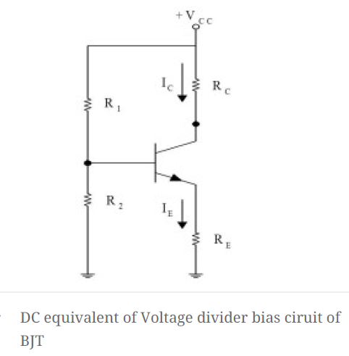
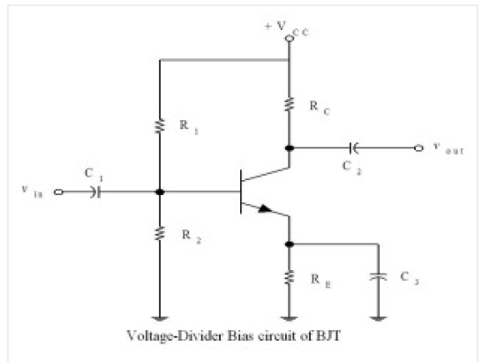
The biasing and blocking capacitors acts as open circuit for DC signals hence can be represented by open circuit terminals . The DC equivalent of amplifier is shown in the figure.

Slide 18
From the DC equivalent circuit by applying KVL in collector loop we get:
V_{ce} = V_{cc} – R_{c}I_{c} ………… (1)
The two points on the line are found as follows:
Cutoff point : To find the cutoff point equate the collector current to zero. In equation 1 equating I_{c} to zero the cutoff point is (V_{cc} , 0).
Saturation point : To find the saturation point equate the collector voltage t zero. In equation 1 equating V_{CE} to zero cutoff point is (0, V_{cc} /R_{c} + R_{E}).
(V_{cc} , 0) is cut off point where transistor enters in to cut off region from active region and (0, V_{cc} / R_{c} + R_{E}) is saturation point where the transistor enters saturation region.

Slide 19
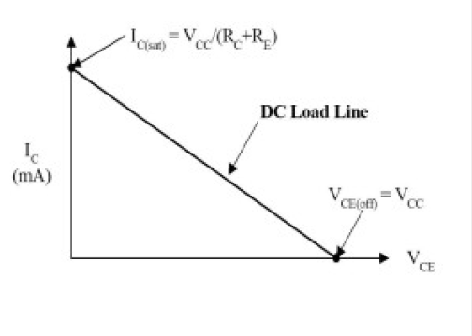

Slide 20
AC Load Line Of A Transistor
The AC load line is a straight line with a slope equal to the AC impedance facing the nonlinear device, which is in general different from the DC resistance.
The ratio of AC voltage to current in the device is defined by this line. Because the impedance of the reactive components will vary with frequency, the slope of the AC load line depends on the frequency of the applied signal.
The ac load line is used to tell the maximum possible output voltage swing for a given common-emitter amplifier.
In other words, the ac load line will tell the maximum possible peak-to-peak output voltage (Vpp ) from a given amplifier.

Slide 21
Ac Load Line Of A Transistor
The ac load line of a given amplifier will not follow the plot of the dc load line.
This is due to the dc load of an amplifier is different from the ac load.

Slide 22
AC Saturation Current and AC Cutoff Voltage

Slide 23
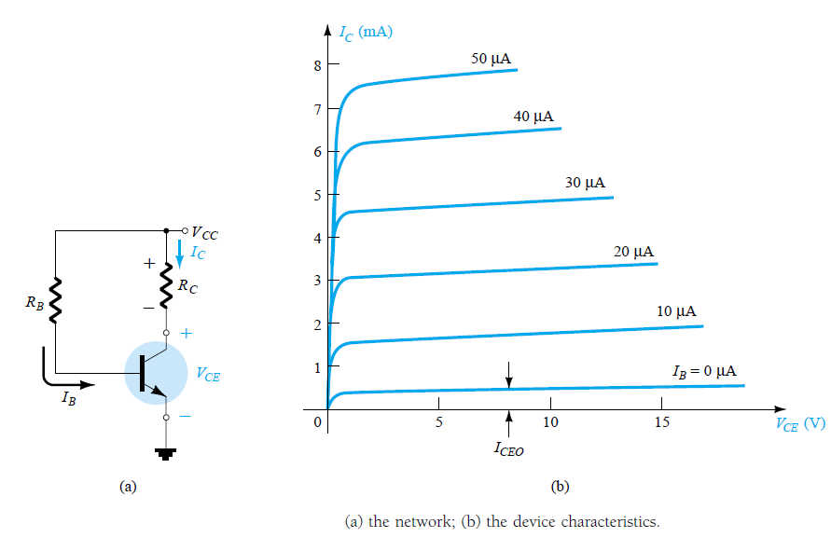

Fixed Biased Circuit fixed biasing is a type of bias where base current is maintained constant for given Vcc by using fixed resistor. so operating point must remain fixed. using this two resistor and fixed current, initial operating point has to found.

Slide 24
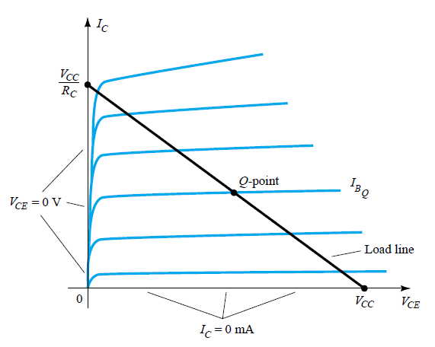


Fixed Biased Load Line

Slide 25
Example
The circuit is midpoint biased.

Slide 26
Base bias characteristics.
Circuit recognition: A single resistor (R_{B}) between the base terminal and V_{CC}. No emitter resistor.
Advantage: Circuit simplicity.
Disadvantage: Q-point shift with temp.
Applications: Switching circuits only.

Slide 27
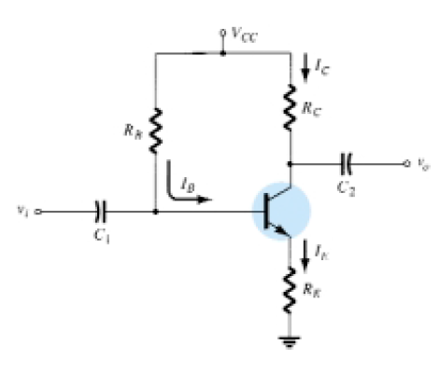
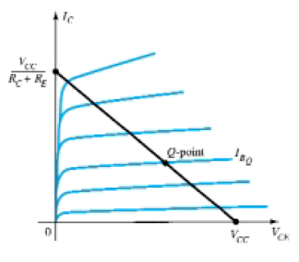



Emitter Biased Circuit

Slide 28
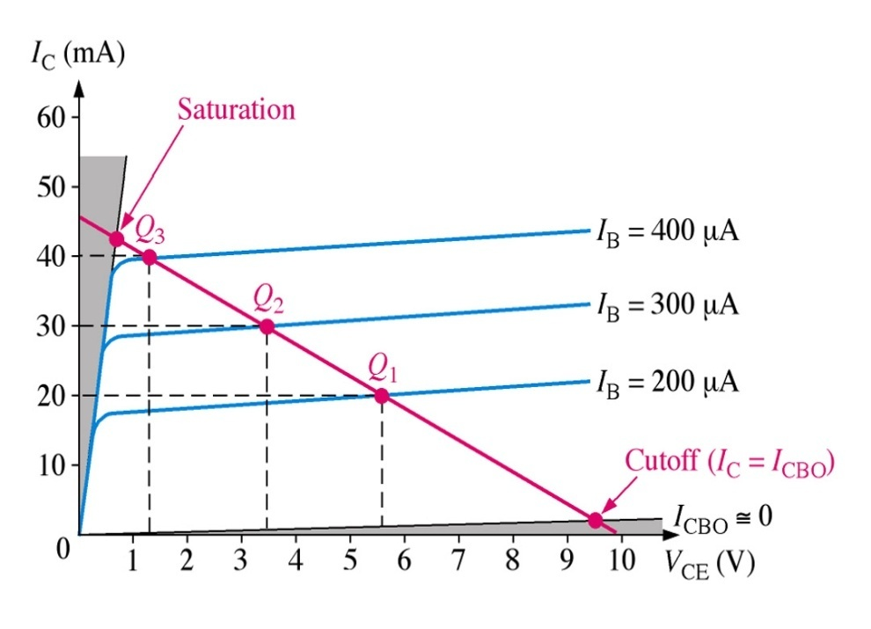
Load Line and Q-point

Slide 29
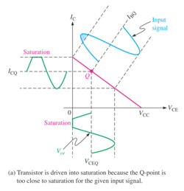
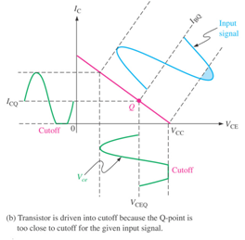
Graphical load line illustration of transistor being driven into
saturation or cutoff

Slide 30
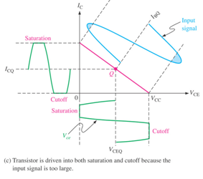
Graphical load line for transistor in saturation and cutoff

Slide 31
Emitter-bias characteristics.
Circuit recognition: A split (dual-polairty) power supply and the base resistor is connected to ground.
Advantage: The circuit Q-point values are stable against changes in h_{FE}.
Disadvantage: Requires the use of dual-polarity power supply.
Applications: Used primarily to bias linear amplifiers.

Slide 32
Example
Plot the dc load line for the circuit shown in Fig. 7.3a.

Slide 33
Example
Plot the dc load line for the circuit shown in Fig. 7.4. Then, find the values of V_{CE} for I_{C} = 1, 2, 5 mA respectively.
I_{C} (mA) | V_{CE} (V)
1 | 9
2 | 8
5 | 5

Slide 34
Collector-Feedback Characteristics
Circuit recognition: The base resistor is connected between the base and the collector terminals of the transistor.
Advantage: A simple circuit with relatively stable Q-point.
Disadvantage: Relatively poor ac characteristics.
Applications: Used primarily to bias linear amplifiers.

Slide 35
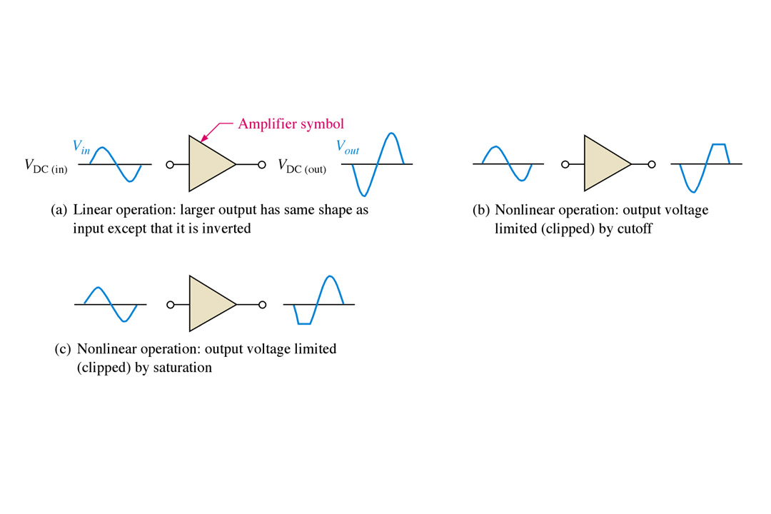
The DC Operating Point
The goal of amplification in most cases is to increase the amplitude of an ac signal without altering it.
Improper biasing can cause distortion in the output signal.
Notes:
Fig 5-1a, b, & c

Slide 36
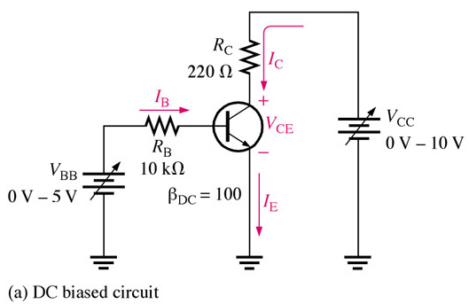
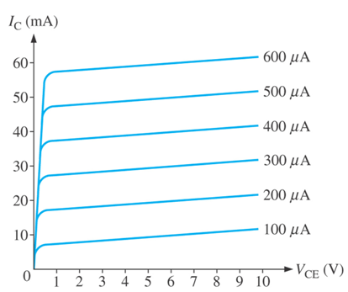
The DC Operating Point
The purpose of biasing a circuit is to establish a proper stable dc operating point (Q-point). The dc operating point between saturation and cutoff is called the Q-point. The goal is to set the Q-point such that that it does not go into saturation or cutoff when an ac signal is applied.
Notes:
Fig 5-2a & Fig 5-4

Slide 37
Optimum Q-point with amplifier operation.

Slide 38
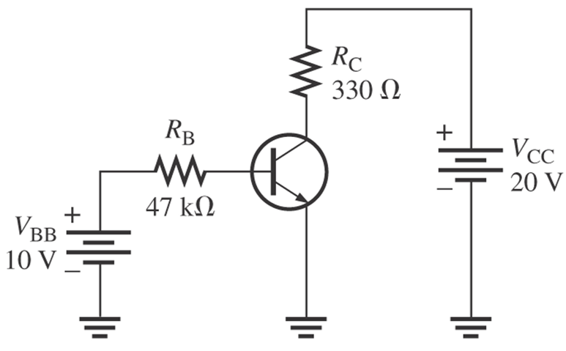
Example 1
Determine Q-point in figure below and find the maximum peak value of base current for linear operation. Assume β_{DC}=200.

Slide 39
Solution
Q-point is defined by values of IC and VCE.
Q-point is at IC=39.6mA and VCE=6.93V. Since IC(cutoff)=0, we need to know IC(sat) to determine variation in IC can occur and still in linear operation.
Before saturation is reached, IC can increase an amount equal to: IC(sat) – ICQ = 60.6mA – 39.6mA = 21mA.

Slide 40
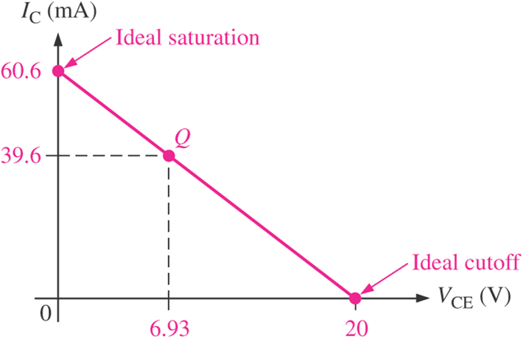
Solution cont..
However, I_{C} can decrease by 39.6mA before cutoff (I_{C}=0) is reached. Since the gap of Q-point with saturation point is less than gap between Q-point and cutoff, so 21mA is the max peak variation of I_{C}.
The max peak variation of I_{B} is:

